Slide 1
The past, present, and future of DNA sequencing
Dan Russell

Slide 2
The past, present, and future of DNA sequencing*
Dan Russell
*DNA sequencing:
Determining the number and order of nucleotides that make up a given molecule of DNA.

Slide 3
(Relevant) Trivia
How many base pairs (bp) are there in a human genome?
How much did it cost to sequence the first human genome?
How long did it take to sequence the first human genome?
When was the first human genome sequence complete?
Whose genome was it?

Slide 4
(Relevant) Trivia
How many base pairs (bp) are there in a human genome?
How much did it cost to sequence the first human genome?
How long did it take to sequence the first human genome?
When was the first human genome sequence complete?
Whose genome was it?
~3 billion (haploid)
~$2.7 billion
~13 years
2000-2003
Several people’s, but actually mostly a dude from Buffalo

Slide 5
Overview
Prologue: Assembly
The Past: Sanger
The Present: Next-Gen (454, Illumina, …)
The Future: ? (Nanopore, MinION, Single-molecule)

Slide 6
Overview
Prologue: Assembly
The Past: Sanger
The Present: Next-Gen (454, Illumina, …)
The Future: ? (Nanopore, MinION, Single-molecule)

Slide 7
Method | Read Length
Sanger
454
Illumina
Ion Torrent

Slide 8
Method | Read Length
Sanger | 600-1000 bp
454
Illumina
Ion Torrent

Slide 9
Method | Read Length
Sanger | 600-1000 bp
454 | 300-500 bp
Illumina
Ion Torrent

Slide 10
Method | Read Length
Sanger | 600-1000 bp
454 | 300-500 bp
Illumina | ~100 bp
Ion Torrent

Slide 11
Method | Read Length
Sanger | 600-1000 bp
454 | 300-500 bp
Illumina | ~100 bp
Ion Torrent | ~200 bp
But…
Phage Genome: 30,000 to 500,000 bp
Bacteria: Several million bp
Human: 3 billion bp

Slide 12
Shotgun Genome Sequencing
Complete genome copies
Fragmented genome chunks

Slide 13
Shotgun Genome Sequencing
Fragmented genome chunks
NOT REALLY DONE BY DUCK HUNTERS
Hydroshearing, sonication, enzymatic shearing
Notes:
Fragment sizes differ for different seq platforms.

Slide 14
All the King’s horses and all the King’s men…
Assembly, aka
17 bp
ATTGTTCCCACAGACCG
CGGCGAAGCATTGTTCC
ACCGTGTTTTCCGACCG
AGCTCGATGCCGGCGAAG
TTGTTCCCACAGACCGTG
TTTCCGACCGAAATGGC
ATGCCGGCGAAGCATTGT
ACAGACCGTGTTTCCCGA
TAATGCGACCTCGATGCC
AAGCATTGTTCCCACAG
TGTTTTCCGACCGAAAT
TGCCGGCGAAGCCTTGT
CCGACCGAAATGGCTCC
66 bp

Slide 15
Assembly
Consensus:
TAATGCGACCTCGATGCCGGCGAAGCATTGTTCCCACAGACCGTGTTTTCCGACCGAAATGGCTCC
ATTGTTCCCACAGACCG
CGGCGAAGCATTGTTCC
ACCGTGTTTTCCGACCG
AGCTCGATGCCGGCGAAG
TTGTTCCCACAGACCGTG
TTTCCGACCGAAATGGC
ATGCCGGCGAAGCATTGT
ACAGACCGTGTTTCCCGA
TAATGCGACCTCGATGCC
AAGCATTGTTCCCACAG
TGTTTTCCGACCGAAAT
TGCCGGCGAAGCCTTGT
CCGACCGAAATGGCTCC

Slide 16
Assembly
Consensus:
TAATGCGACCTCGATGCCGGCGAAGCATTGTTCCCACAGACCGTGTTTTCCGACCGAAATGGCTCC
ATTGTTCCCACAGACCG
CGGCGAAGCATTGTTCC
ACCGTGTTTTCCGACCG
AGCTCGATGCCGGCGAAG
TTGTTCCCACAGACCGTG
TTTCCGACCGAAATGGC
ATGCCGGCGAAGCATTGT
ACAGACCGTGTTTCCCGA
TAATGCGACCTCGATGCC
AAGCATTGTTCCCACAG
TGTTTTCCGACCGAAAT
TGCCGGCGAAGCCTTGT
CCGACCGAAATGGCTCC
Coverage: # of reads underlying the consensus

Slide 17
Assembly
Consensus:
TAATGCGACCTCGATGCCGGCGAAGCATTGTTCCCACAGACCGTGTTTTCCGACCGAAATGGCTCC
ATTGTTCCCACAGACCG
CGGCGAAGCATTGTTCC
ACCGTGTTTTCCGACCG
AGCTCGATGCCGGCGAAG
TTGTTCCCACAGACCGTG
TTTCCGACCGAAATGGC
ATGCCGGCGAAGCATTGT
ACAGACCGTGTTTCCCGA
TAATGCGACCTCGATGCC
AAGCATTGTTCCCACAG
TGTTTTCCGACCGAAAT
TGCCGGCGAAGCCTTGT
CCGACCGAAATGGCTCC
6x coverage
100% identity
Coverage: # of reads underlying the consensus

Slide 18
Assembly
Consensus:
TAATGCGACCTCGATGCCGGCGAAGCATTGTTCCCACAGACCGTGTTTTCCGACCGAAATGGCTCC
ATTGTTCCCACAGACCG
CGGCGAAGCATTGTTCC
ACCGTGTTTTCCGACCG
AGCTCGATGCCGGCGAAG
TTGTTCCCACAGACCGTG
TTTCCGACCGAAATGGC
ATGCCGGCGAAGCATTGT
ACAGACCGTGTTTCCCGA
TAATGCGACCTCGATGCC
AAGCATTGTTCCCACAG
TGTTTTCCGACCGAAAT
TGCCGGCGAAGCCTTGT
CCGACCGAAATGGCTCC
5x coverage
80% identity
Coverage: # of reads underlying the consensus

Slide 19
Assembly
Consensus:
TAATGCGACCTCGATGCCGGCGAAGCATTGTTCCCACAGACCGTGTTTTCCGACCGAAATGGCTCC
ATTGTTCCCACAGACCG
CGGCGAAGCATTGTTCC
ACCGTGTTTTCCGACCG
AGCTCGATGCCGGCGAAG
TTGTTCCCACAGACCGTG
TTTCCGACCGAAATGGC
ATGCCGGCGAAGCATTGT
ACAGACCGTGTTTCCCGA
TAATGCGACCTCGATGCC
AAGCATTGTTCCCACAG
TGTTTTCCGACCGAAAT
TGCCGGCGAAGCCTTGT
CCGACCGAAATGGCTCC
2x coverage
50% identity
Coverage: # of reads underlying the consensus

Slide 20
Assembly
Consensus:
TAATGCGACCTCGATGCCGGCGAAGCATTGTTCCCACAGACCGTGTTTTCCGACCGAAATGGCTCC
ATTGTTCCCACAGACCG
CGGCGAAGCATTGTTCC
ACCGTGTTTTCCGACCG
AGCTCGATGCCGGCGAAG
TTGTTCCCACAGACCGTG
TTTCCGACCGAAATGGC
ATGCCGGCGAAGCATTGT
ACAGACCGTGTTTCCCGA
TAATGCGACCTCGATGCC
AAGCATTGTTCCCACAG
TGTTTTCCGACCGAAAT
TGCCGGCGAAGCCTTGT
CCGACCGAAATGGCTCC
1x coverage
Coverage: # of reads underlying the consensus

Slide 21
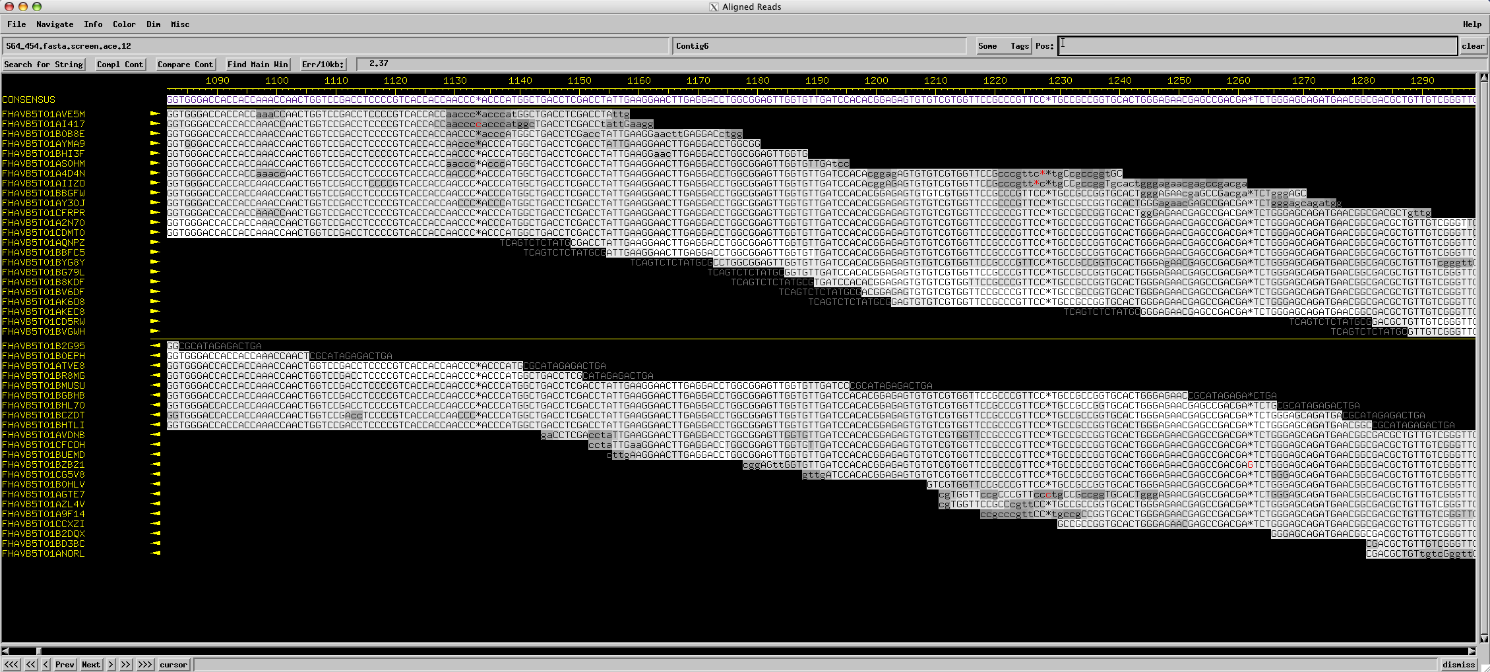
Assembly

Slide 22
Overview
Prologue: Assembly
The Past: Sanger
The Present: Next-Gen (454, Illumina, …)
The Future: ? (Nanopore, MinION, Single-molecule)

Slide 23
Fragments were cloned:

Slide 24
x millions
x millions
Notes:
One tube per 2 sequences with Sanger and cloning. Not so bad if you only want 100 sequences. What if you want 1 million?

Slide 25
x millions
x millions
Notes:
One tube per 2 sequences with Sanger and cloning. Not so bad if you only want 100 sequences. What if you want 1 million?

Slide 26
Sanger Sequencing Reactions
For given template DNA, it’s like PCR except:
Uses only a single primer and polymerase to make new ssDNA pieces.
Includes regular nucleotides (A, C, G, T) for extension, but also includes dideoxy nucleotides.
Dideoxy Nucleotides
G
A
T
C
Regular Nucleotides
T
C
G
A
C
G
A
T
G
G
A
T
G
T
C
G
A
A
T
A
C
T
G
G
A
T
A
T
G
Labeled
Terminators
T
A
C
C
G
A
C
C
A
T
A
C
G

Slide 27
Sanger Sequencing
Primer
5’
T G C G C G G C C C A
A C G C G C C G G G T ? ? ? ? ? ? ? ? ? ? ? ? ? ? ?
3’
5’

Slide 28
Sanger Sequencing
Primer
5’
G T C T T G G G C T
T G C G C G G C C C A
A C G C G C C G G G T C A G A A C C C G A T C G C G
3’
5’

Slide 29
Sanger Sequencing
Primer
5’
G T C T T G G G C T A G C G C
T G C G C G G C C C A
A C G C G C C G G G T C A G A A C C C G A T C G C G
3’
5’
5’
21 bp
G T C T T G G G C T
T G C G C G G C C C A

Slide 30
Sanger Sequencing
Primer
5’
G T C T T G G G C T A
T G C G C G G C C C A
A C G C G C C G G G T C A G A A C C C G A T C G C G
3’
5’
5’
21 bp
G T C T T G G G C T
T G C G C G G C C C A
5’
26 bp
G T C T T G G G C T A G C G C
T G C G C G G C C C A

Slide 31
Sanger Sequencing
Primer
5’
G
T G C G C G G C C C A
A C G C G C C G G G T C A G A A C C C G A T C G C G
3’
5’
5’
21 bp
G T C T T G G G C T
T G C G C G G C C C A
5’
26 bp
G T C T T G G G C T A G C G C
T G C G C G G C C C A
5’
22 bp
G T C T T G G G C T A
T G C G C G G C C C A

Slide 32
Sanger Sequencing
Primer
5’
G T C T T G G G C
T G C G C G G C C C A
A C G C G C C G G G T C A G A A C C C G A T C G C G
3’
5’
5’
21 bp
G T C T T G G G C T
T G C G C G G C C C A
5’
26 bp
G T C T T G G G C T A G C G C
T G C G C G G C C C A
5’
22 bp
G T C T T G G G C T A
T G C G C G G C C C A
5’
12 bp
G
T G C G C G G C C C A

Slide 33
Sanger Sequencing
Primer
5’
G T C T T
T G C G C G G C C C A
A C G C G C C G G G T C A G A A C C C G A T C G C G
3’
5’
5’
21 bp
G T C T T G G G C T
T G C G C G G C C C A
5’
26 bp
G T C T T G G G C T A G C G C
T G C G C G G C C C A
5’
22 bp
G T C T T G G G C T A
T G C G C G G C C C A
5’
12 bp
G
T G C G C G G C C C A
5’
20 bp
T G C G C G G C C C A
G T C T T G G G C

Slide 34
Sanger Sequencing
A C G C G C C G G G T C A G A A C C C G A T C G C G
3’
5’
5’
21 bp
G T C T T G G G C T
T G C G C G G C C C A
5’
26 bp
G T C T T G G G C T A G C G C
T G C G C G G C C C A
5’
22 bp
G T C T T G G G C T A
T G C G C G G C C C A
5’
12 bp
G
T G C G C G G C C C A
5’
20 bp
T G C G C G G C C C A
G T C T T G G G C
5’
16 bp
G T C T T
T G C G C G G C C C A

Slide 35
Sanger Sequencing
A C G C G C C G G G T ? ? ? ? ? ? ? ? ? ? ? ? ? ? ?
3’
5’
5’
21 bp
? ? ? ? ? ? ? ? ? T
T G C G C G G C C C A
5’
26 bp
? ? ? ? ? ? ? ? ? ? ? ? ? ? C
T G C G C G G C C C A
5’
22 bp
? ? ? ? ? ? ? ? ? ? A
T G C G C G G C C C A
5’
12 bp
G
T G C G C G G C C C A
5’
20 bp
T G C G C G G C C C A
? ? ? ? ? ? ? ? C
5’
16 bp
? ? ? ? T
T G C G C G G C C C A
Notes:
Has to be done in a single tube per rxn.

Slide 36
Sanger Sequencing
Laser Reader
5’
5’
5’
5’
5’
5’
5’
5’
5’
5’
5’
20 bp
21 bp
19 bp
13 bp
18 bp
22 bp
16 bp
14 bp
15 bp
17 bp
12 bp
G T C T T G G G C
T G C G C G G C C C A
G T C T T G G G C T
T G C G C G G C C C A
G T C T T G G G
T G C G C G G C C C A
G T C T T G G
T G C G C G G C C C A
T G C G C G G C C C A
G T C T T G G G C T A
G
G T
G T C T T
G T C T
G T C T T G
T G C G C G G C C C A
T G C G C G G C C C A
T G C G C G G C C C A
T G C G C G G C C C A
T G C G C G G C C C A
T G C G C G G C C C A
G T C

Slide 37
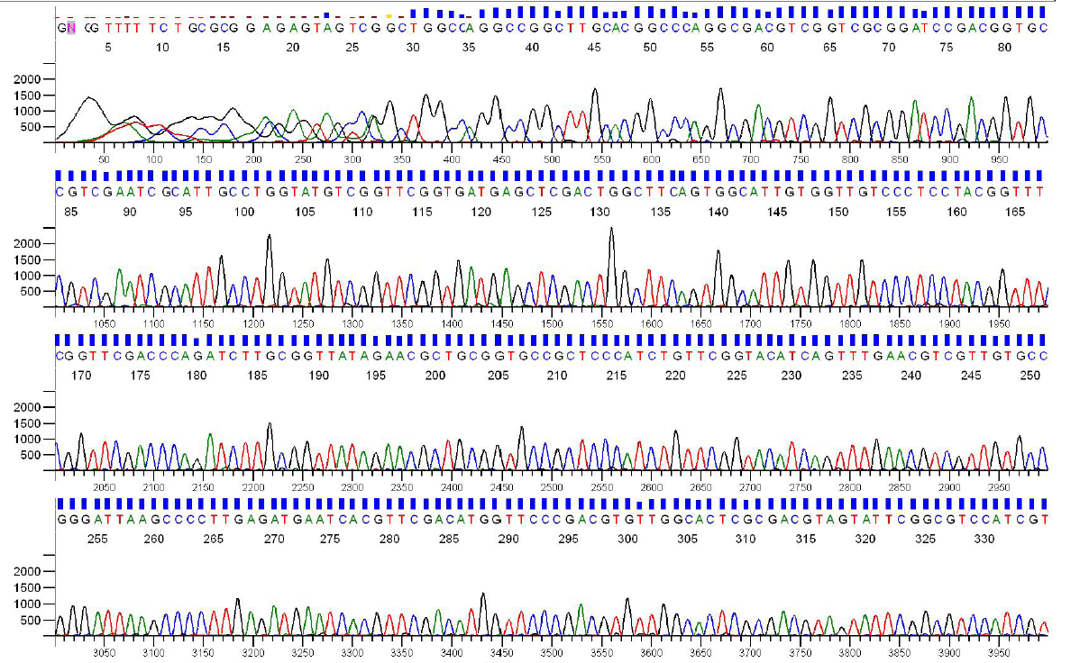
Sanger Sequencing Output
Each sequencing reaction gives us a chromatogram, usually ~600-1000 bp:

Slide 38
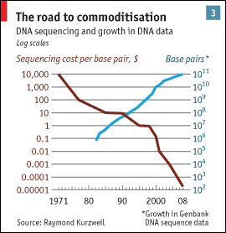
Sanger Throughput Limitations
Must have 1 colony picked for every 2 reactions
Must do 1 DNA prep for every 2 reactions
Must have 1 PCR tube for each reaction
Must have 1 gel lane for each reaction
from The Economist

Slide 39
Overview
Prologue: Assembly
The Past: Sanger
The Present: Next-Gen (454, Illumina, …)
The Future: ? (Nanopore, MinION, Single-molecule)

Slide 40
Shotgun sequencing by Ion Torrent Personal Genome Machine and 454

Slide 41
Shotgun sequencing by PGM/454
Genomic
Fragment
Adapters

Slide 42
Shotgun sequencing by PGM/454
Genomic
Fragment
Barcode

Slide 43
Shotgun sequencing by PGM/454

Slide 44
Shotgun sequencing by PGM/454
Bead/ISP
Adapter
Complement
Sequences
The idea is that each bead should be amplified
all over with a SINGLE library fragment.

Slide 45
Shotgun sequencing by PGM/454
Problem: How do I do PCR to amplify the fragments without having to use 1 tube for each reaction?

Slide 46
Shotgun sequencing by PGM/454

Slide 47
Shotgun sequencing by PGM/454

Slide 48
Shotgun sequencing by PGM/454

Slide 49
Shotgun sequencing by PGM/454

Slide 50
Shotgun sequencing by PGM/454

Slide 51
Shotgun sequencing by PGM/454

Slide 52
Shotgun sequencing by PGM/454

Slide 53
Shotgun sequencing by PGM/454

Slide 54
Shotgun sequencing by PGM/454

Slide 55
Shotgun sequencing by PGM/454

Slide 56
Shotgun sequencing by PGM/454
~3.5 µm for Ion Torrent, ~30 µm for 454

Slide 57
Shotgun sequencing by PGM/454
Only give polymerase one nucleotide at a time:
T
T
T
Primer
T
T
5’
T G C G C G G C C C A
A C G C G C C G G G T C A G A A C C C G A T C G C G
3’
5’
If that nucleotide is incorporated, enzymes turn by-products into light:
1 2 3 4 5
T C A G T C A G T C A G

Slide 58
Shotgun sequencing by PGM/454
Only give polymerase one nucleotide at a time:
A
A
A
Primer
A
A
5’
T G C G C G G C C C A
A C G C G C C G G G T C A G A A C C C G A T C G C G
3’
5’
If that nucleotide is incorporated, enzymes turn by-products into light:
1 2 3 4 5
T C A G T C A G T C A G

Slide 59
Shotgun sequencing by PGM/454
Only give polymerase one nucleotide at a time:
G
G
G
Primer
G
G
5’
G
T G C G C G G C C C A
A C G C G C C G G G T C A G A A C C C G A T C G C G
3’
5’
If that nucleotide is incorporated, enzymes turn by-products into light:
1 2 3 4 5
T C A G T C A G T C A G

Slide 60
Shotgun sequencing by PGM/454
Only give polymerase one nucleotide at a time:
T
T
T
Primer
T
T
5’
G
T
T G C G C G G C C C A
A C G C G C C G G G T C A G A A C C C G A T C G C G
3’
5’
If that nucleotide is incorporated, enzymes turn by-products into light:
1 2 3 4 5
T C A G T C A G T C A G

Slide 61
Shotgun sequencing by PGM/454
Only give polymerase one nucleotide at a time:
C
C
C
Primer
C
C
5’
G
T
T G C G C G G C C C A
C
A C G C G C C G G G T C A G A A C C C G A T C G C G
3’
5’
If that nucleotide is incorporated, enzymes turn by-products into light:
1 2 3 4 5
T C A G T C A G T C A G

Slide 62
Shotgun sequencing by PGM/454
Only give polymerase one nucleotide at a time:
A
A
A
Primer
A
A
5’
G
T
T G C G C G G C C C A
C
A C G C G C C G G G T C A G A A C C C G A T C G C G
3’
5’
If that nucleotide is incorporated, enzymes turn by-products into light:
1 2 3 4 5
T C A G T C A G T C A G

Slide 63
Shotgun sequencing by PGM/454
Only give polymerase one nucleotide at a time:
T
T
T
Primer
T
T
5’
G
T
T G C G C G G C C C A
C
T T
A C G C G C C G G G T C A G A A C C C G A T C G C G
3’
5’
If that nucleotide is incorporated, enzymes turn by-products into light:
1 2 3 4 5
T C A G T C A G T C A G

Slide 64
Shotgun sequencing by PGM/454
Only give polymerase one nucleotide at a time:
G
G
G
Primer
G
G
5’
G
T
T G C G C G G C C C A
C
T T
G G G
A C G C G C C G G G T C A G A A C C C G A T C G C G
3’
5’
If that nucleotide is incorporated, enzymes turn by-products into light:
1 2 3 4 5
The real power of this method is that it can take place in millions of tiny wells in a single plate at once.
T C A G T C A G T C A G

Slide 65
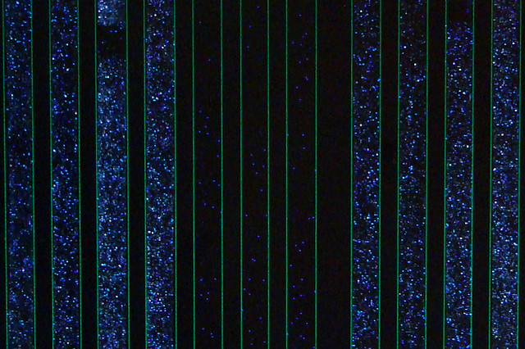
Raw 454 data
Only give polymerase one nucleotide at a time:
G
G
G
Primer
G
G
5’
G
T
T G C G C G G C C C A
C
T T
G G G
A C G C G C C G G G T C A G A A C C C G A T C G C G
3’
5’
If that nucleotide is incorporated, enzymes turn by-products into light:
1 2 3 4 5
The real power of this method is that it can take place in millions of tiny wells in a single plate at once.
T C A G T C A G T C A G

Slide 66
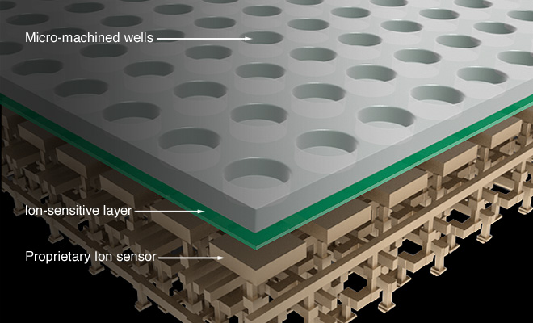
Ion Torrent Sequencing

Slide 67
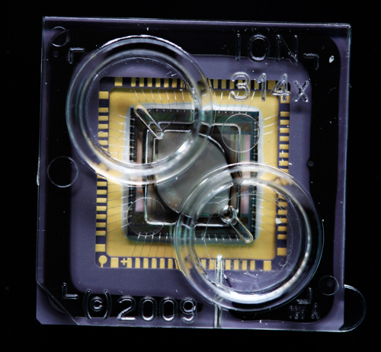
Ion Torrent Sequencing

Slide 68
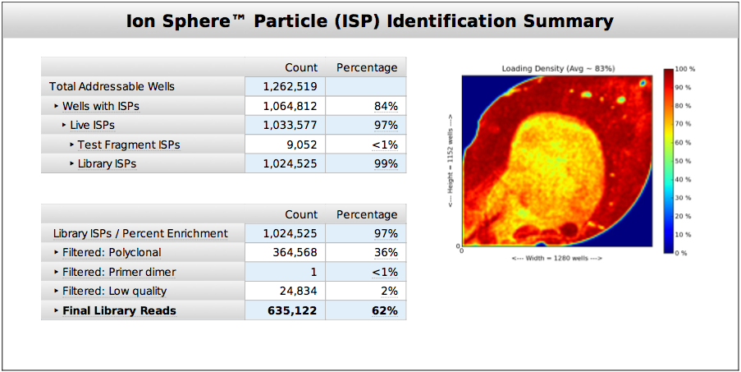
Ion Torrent Sequencing

Slide 69
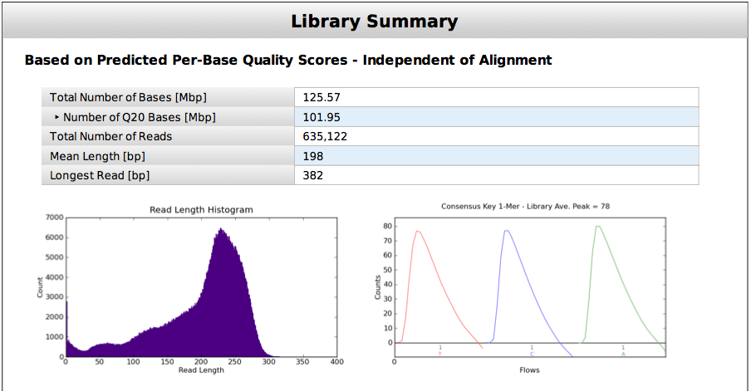
Ion Torrent Sequencing

Slide 70
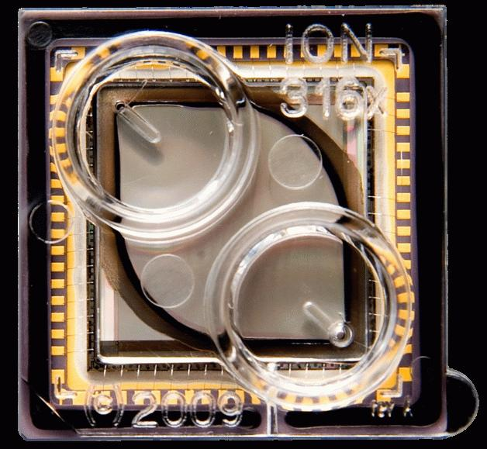
Ion Torrent Sequencing

Slide 71
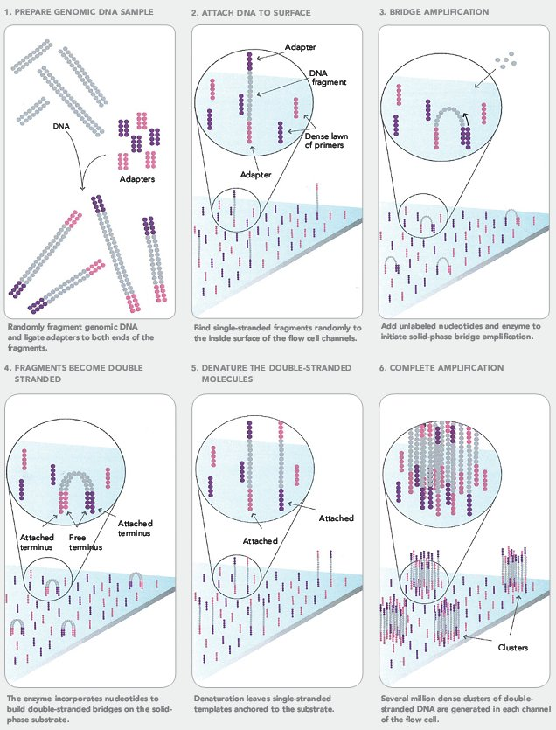
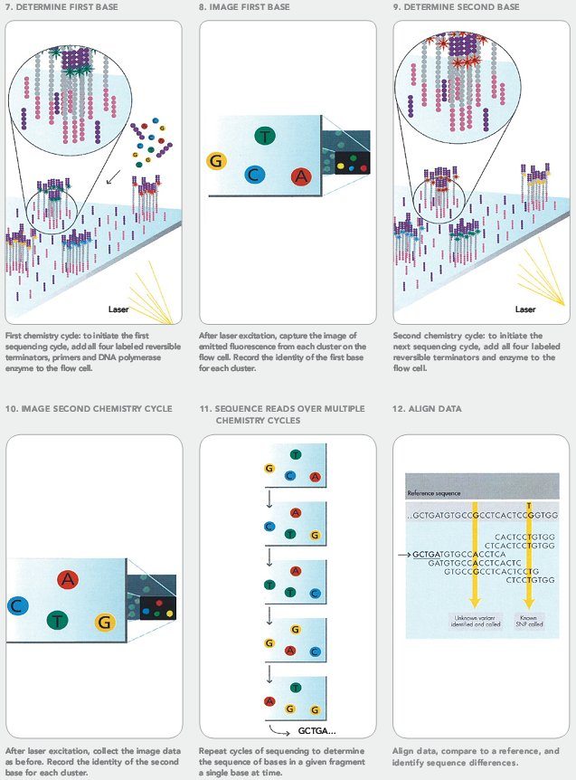
Illumina Sequencing

Slide 72
Next-Gen Sequencing
Take home message: Massively Parallel
1,000 monkeys at 1,000 typewriters is nothing
We’re talking 100,000 to 100 million concurrent reads

Slide 73
Overview
Prologue: Assembly
The Past: Sanger
The Present: Next-Gen (454, Illumina, …)
The Future: ? (Nanopore, MinION, Single-molecule)

Slide 74
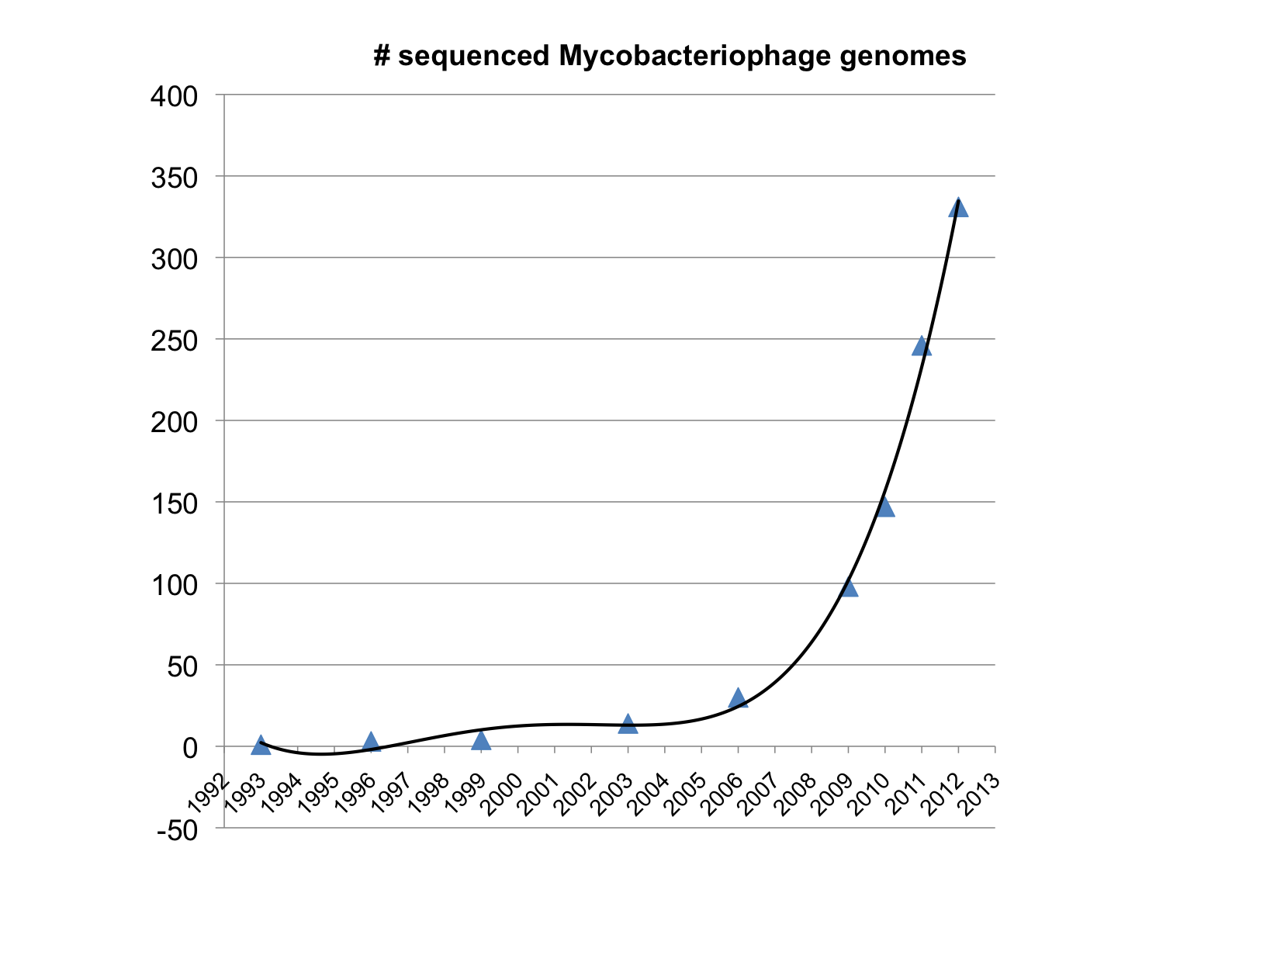
Largely because of PHIRE and SEA-PHAGES…

Slide 75
DNA Sequencing over Time
from The Economist
Notes:
Amazing growth in info and concurrent drop in price.
Story about 1 base thesis.
Now 1/1000 cent per base.

Slide 76
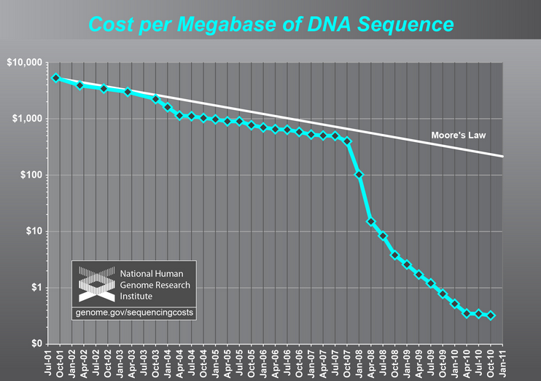

Slide 77
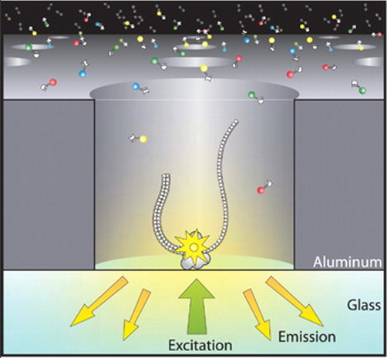
Single Molecule Sequencing

Slide 78
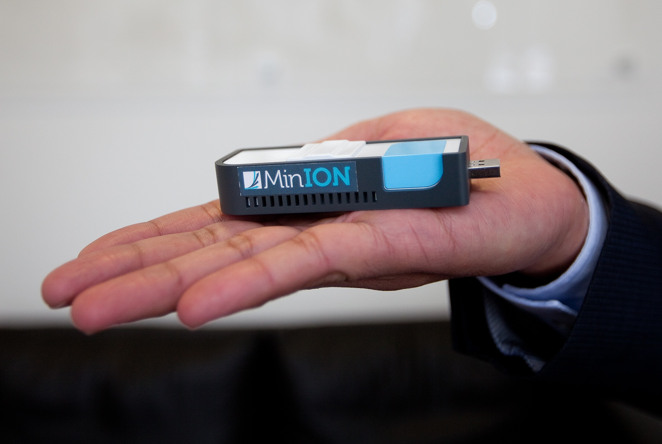
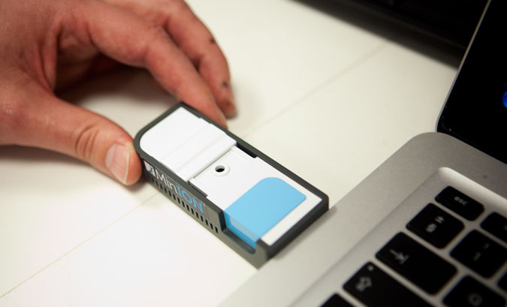

Slide 79
“The MinION has been used to successfully read the genome of a lambda bacteriophage, which has 48,500-ish base pairs, twice during one pass. That's impressive, because reading 100,000 base pairs during a single DNA capture has never been managed before using traditional sequencing techniques.
The operational life of the MinION is only about six hours, but during that time it can read more than 150 million base pairs. That's somewhat short of the larger human chromosomes (which contain up to 250 million base pairs), but Oxford Nanopore has also introduced GridION -- a platform where multiple cartridges can be clustered together. The company reckon that a 20-node GridION setup can sequence a complete human genome in just 15 minutes.”
—Wired

Slide 80
(Relevant) Trivia
How many base pairs (bp) are there in a human genome?
How much did it cost to sequence the first human genome?
How long did it take to sequence the first human genome?
When was the first human genome sequence complete?
Whose genome was it?
~3 billion (haploid)
~$2.7 billion
~13 years
2000-2003
Several people’s, but actually mostly a dude from Buffalo

Slide 81
Final Thoughts
DNA sequencing is becoming vastly faster and more affordable
Generating data is no longer the bottleneck, understanding it is
Bioinformatics types should be in high demand in the near future

Slide 83
Epilogue
So should we really still be sequencing more mycobacteriophage genomes? We have 250+…

Slide 84
Chimps vs. Humans
At the DNA level…
> 95% similar
Cluster A vs. Cluster B Mycobacteriophages
< 50% similar
…but that’s just one pair of clusters, how many are there?

Slide 85
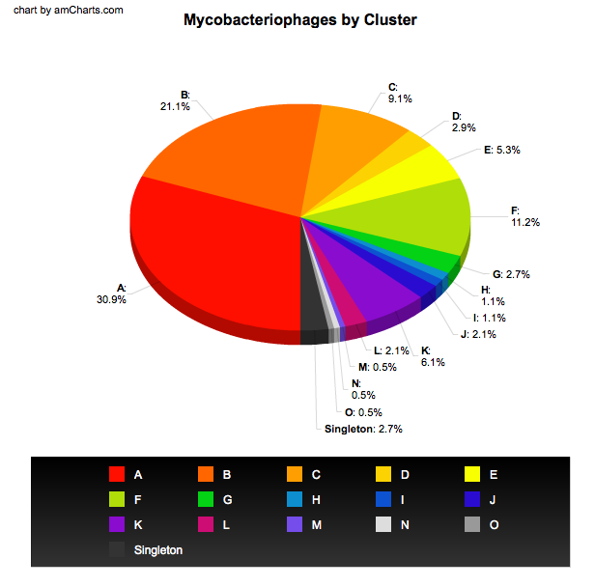
DNA Sequencing over Time
from The Economist
Notes:
Amazing growth in info and concurrent drop in price.
Story about 1 base thesis.
Now 1/1000 cent per base.

Slide 86
Comparing Different Technologies
Sanger Sequencing
Advantages | Disadvantages
Lowest error rate Long read length (~750 bp) Can target a primer | High cost per base Long time to generate data Need for cloning Amount of data per run

Slide 87
Comparing Different Technologies
454 Sequencing
Advantages | Disadvantages
Low error rate Medium read length (~400-600 bp) | Relatively high cost per base Must run at large scale Medium/high startup costs

Slide 88
Comparing Different Technologies
Ion Torrent Sequencing
Advantages | Disadvantages
Low startup costs Scalable (10 – 1000 Mb of data per run) Medium/low cost per base Low error rate Fast runs (<3 hours) | New, developing technology Cost not as low as Illumina Read lengths only ~100-200 bp so far

Slide 89
Comparing Different Technologies
Illumina Sequencing
Advantages | Disadvantages
Low error rate Lowest cost per base Tons of data | Must run at very large scale Short read length (50-75 bp) Runs take multiple days High startup costs De Novo assembly difficult

Slide 90
Comparing Different Technologies
PacBio Sequencing
Advantages | Disadvantages
Can use single molecule as template Potential for very long reads (several kb+) | High error rate (~10-15%) Medium/high cost per base High startup costs

