Slide 1
Cluster Analysis
SPH 247
Statistical Analysis of
Laboratory Data

Slide 2
Supervised and Unsupervised Learning
Logistic regression and Fisher’s LDA and QDA are examples of supervised learning.
This means that there is a ‘training set’ which contains known classifications into groups that can be used to derive a classification rule.
This can be then evaluated on a ‘test set’, or this can be done repeatedly using cross validation.

Slide 3
Unsupervised Learning
Unsupervised learning means (in this instance) that we are trying to discover a division of objects into classes without any training set of known classes, without knowing in advance what the classes are, or even how many classes there are.
It should not have to be said that this is a difficult task

Slide 4
Cluster Analysis
‘Cluster analysis’, or simply ‘clustering’ is a collection of methods for unsupervised class discovery
These methods are widely used for gene expression data, proteomics data, and other omics data types
They are likely more widely used than they should be
One can cluster subjects (types of cancer) or genes (to find pathways or co-regulation) or both at the same time.

Slide 5
Distance Measures
It turns out that the most crucial decision to make in choosing a clustering method is defining what it means for two vectors to be close or far.
There are other components to the choice, but these are all secondary
Often the distance measure is implicit in the choice of method, but a wise decision maker knows what he/she is choosing.

Slide 6
A true distance, or metric, is a function defined on pairs of objects that satisfies a number of properties:
  D(x,y) = D(y,x)
  D(x,y) ≥ 0
  D(x,y) = 0 ⇔ x = y
  D(x,y) + D(y,z) ≥ D(x,z) (triangle inequality)
The classic example of a metric is Euclidean distance. If x = (x₁,x₂,…x_{p}), and y=(y₁,y₂,…y_{p}) , are vectors, the Euclidean distance is √[(x₁-y₁)²+ ☹(x_{p}-y_{p})²]

Slide 7
Euclidean Distance
y = (y₁,y₂)
D(x,y)
|x₂-y₂|
|x₁-y₁|
x = (x₁,x₂)

Slide 8
Triangle Inequality
x
D(x,z)
D(x,y)
y
D(y,z)
z

Slide 9
Other Metrics
The city block metric is the distance when only horizontal and vertical travel is allowed, as in walking in a city.
It turns out to be
|x₁-y₁|+ ☹|x_{p}-y_{p}|
instead of the Euclidean distance
√[(x₁-y₁)²+ ☹(x_{p}-y_{p})²]

Slide 10
Mahalanobis Distance
Mahalanobis distance is a kind of weighted Euclidean distance
It produces distance contours of the same shape as a data distribution
It is often more appropriate than Euclidean distance when there are not too many variables

Slide 11
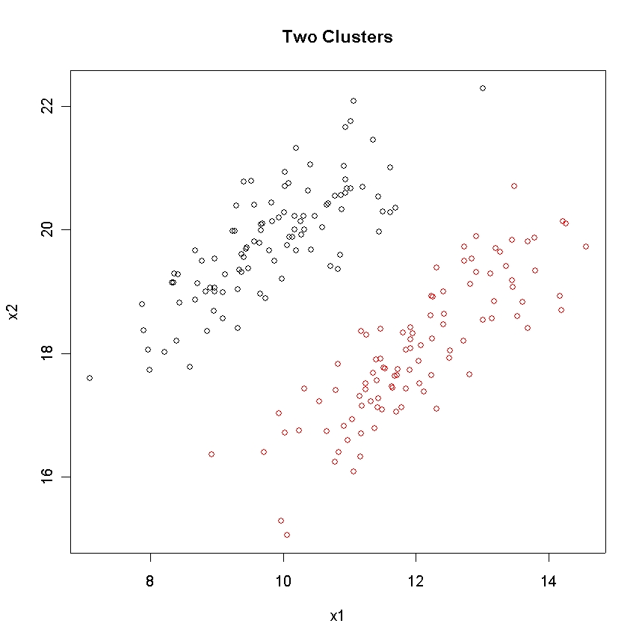

Slide 12
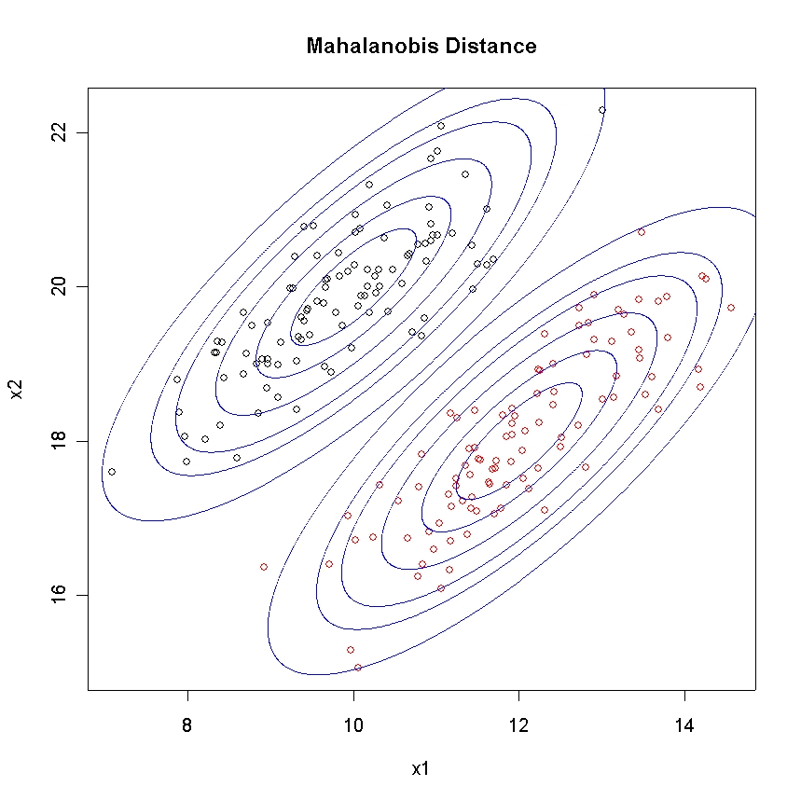

Slide 13
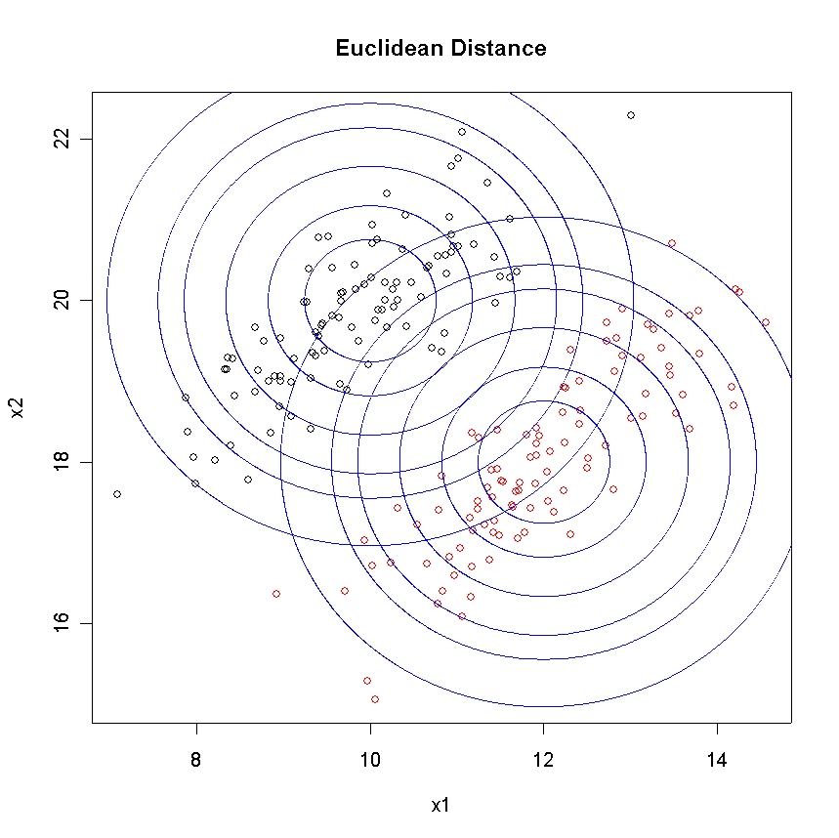

Slide 14
Non-Metric Measures of Similarity
A common measure of similarity used for microarray data is the (absolute) correlation.
This rates two data vectors as similar if they move up and down together, without worrying about their absolute magnitudes
This is not a metric, since if violates several of the required properties
We could use 1 - |ρ| as the “distance”

Slide 15
Agglomerative Hierarchical Clustering
We start with all data items as individuals
In step 1, we join the two closest individuals
In each subsequent step, we join the two closest individuals or clusters
This requires defining the distance between two groups as a number that can be compared to the distance between individuals
We can use the R commands hclust or agnes

Slide 16
Group Distances
Complete link clustering defines the distance between two groups as the maximum distance between any element of one group and any of the other
Single link clustering defines the distance between two groups as the minimum distance between any element of one group and any of the other
Average link clustering defines the distance between two groups as the mean distance between elements of one group and elements of the other

Slide 17
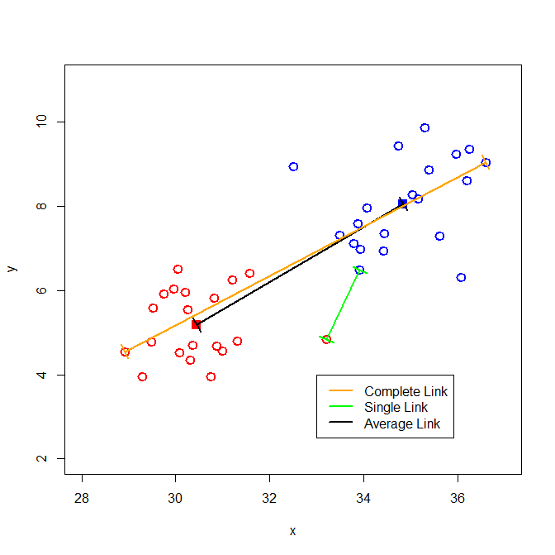

Slide 18
> iris.d <- dist(iris[,1:4])
> iris.hc <- hclust(iris.d)
> plot(iris.hc)
> par(pin=c(10,5))
> par(cex=.8)
> plot(iris.hc,labels=rep(c("S","C","I"),each=50),
xlab="",sub="",ylab="",main="Iris Cluster Plot")
> plot(hclust(dist(t(exprs(eset.lmg)))))
> plot(hclust(as.dist(1-cor(exprs(eset.lmg))^2)))

Slide 19
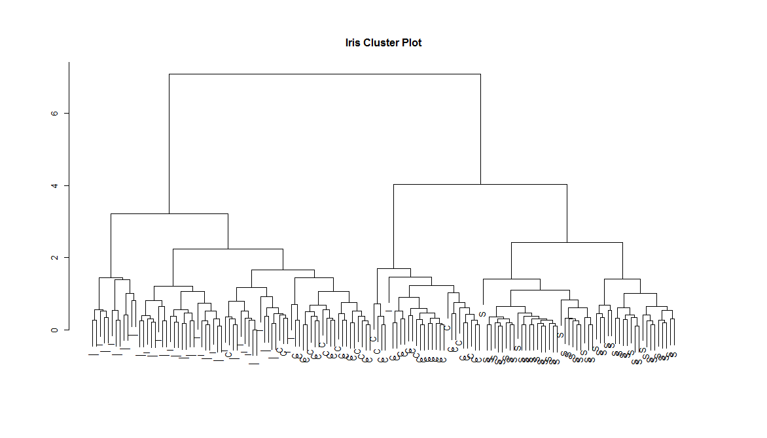

Slide 20
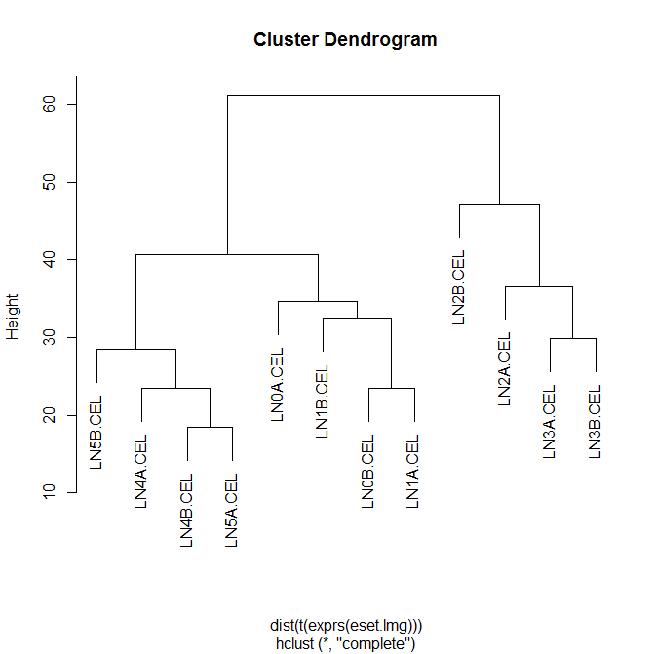

Slide 21
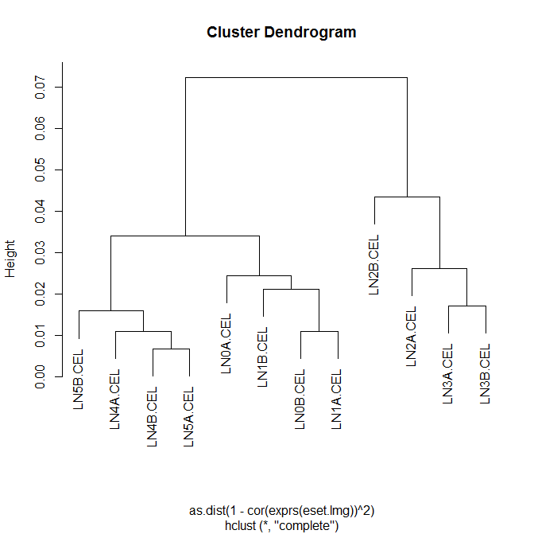

Slide 22
Divisive Clustering
Divisive clustering begins with the whole data set as a cluster, and considers dividing it into k clusters.
Usually this is done to optimize some criterion such as the ratio of the within cluster variation to the between cluster variation
The choice of k is important

Slide 23
K-means is a widely used divisive algorithm (R command kmeans)
Its major weakness is that it uses Euclidean distance
Some other routines in R for divisive clustering include agnes and fanny in the cluster package (library(cluster))

Slide 24
> iris.km <- kmeans(iris[,1:4],3)
> plot(prcomp(iris[,1:4])$x,col=iris.km$cluster)
>
> table(iris.km$cluster,iris[,5])
setosa versicolor virginica
1 0 48 14
2 0 2 36
3 50 0 0
>

Slide 25
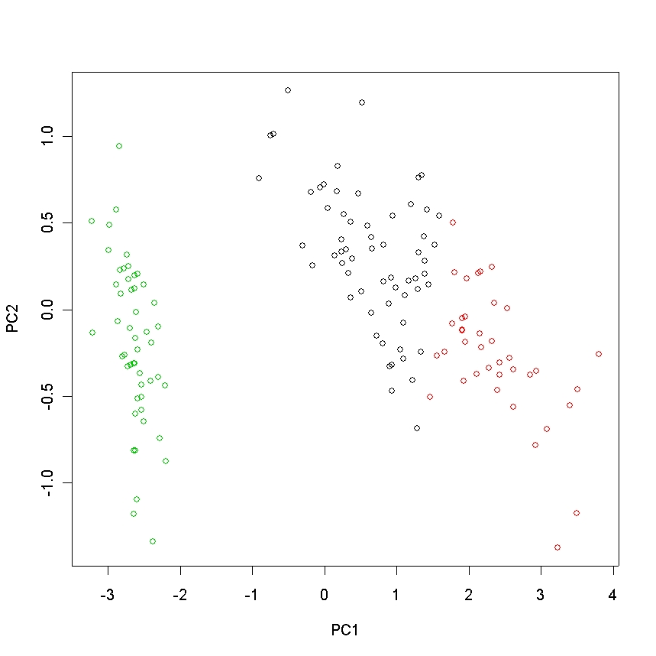

Slide 26
> rice.km2 <- kmeans(t(exprs(eset.lmg)),2)
> rice.km3 <- kmeans(t(exprs(eset.lmg)),3)
> rice.km4 <- kmeans(t(exprs(eset.lmg)),4)
> rice.km5 <- kmeans(t(exprs(eset.lmg)),5)
> rice.km6 <- kmeans(t(exprs(eset.lmg)),6)

Slide 27
> table(rice.km2$cluster,group)
group
0 1 2 3 4 5
1 0 0 2 2 0 0
2 2 2 0 0 2 2
> table(rice.km3$cluster,group)
group
0 1 2 3 4 5
1 2 2 0 0 0 0
2 0 0 2 2 0 0
3 0 0 0 0 2 2
> table(rice.km4$cluster,group)
group
0 1 2 3 4 5
1 0 0 0 0 2 2
2 0 0 2 2 0 0
3 1 0 0 0 0 0
4 1 2 0 0 0 0
> table(rice.km5$cluster,group)
group
0 1 2 3 4 5
1 0 0 1 2 0 0
2 0 0 0 0 2 2
3 1 0 0 0 0 0
4 0 0 1 0 0 0

Slide 28
> table(rice.km6$cluster,group)
group
0 1 2 3 4 5
1 1 0 0 0 0 0
2 0 0 0 0 2 1
3 1 2 0 0 0 0
4 0 0 0 0 0 1
5 0 0 1 2 0 0
6 0 0 1 0 0 0

Slide 29
Model-based clustering methods allow use of more flexible shape matrices. One such package is mclust, which needs to be downloaded from CRAN
Functions in this package include EMclust (more flexible), Mclust (simpler to use)
Other excellent software is EMMIX from Geoff McLachlan at the University of Queensland.

Slide 30
Models compared in mclust:
univariateMixture A vector with the following components:
"E": equal variance (one-dimensional)
"V": variable variance (one-dimensional)
multivariateMixture A vector with the following components:
"EII": spherical, equal volume
"VII": spherical, unequal volume
"EEI": diagonal, equal volume and shape
"VEI": diagonal, varying volume, equal shape
"EVI": diagonal, equal volume, varying shape
"VVI": diagonal, varying volume and shape
"EEE": ellipsoidal, equal volume, shape, and orientation
"EEV": ellipsoidal, equal volume and equal shape
"VEV": ellipsoidal, equal shape
"VVV": ellipsoidal, varying volume, shape, and orientation
singleComponent A vector with the following components:
"X": one-dimensional
"XII": spherical
"XXI": diagonal
"XXX": ellipsoidal

Slide 31
> data(iris)
> mc.obj <- Mclust(iris[,1:4])
> plot.Mclust(mc.obj,iris[1:4])

Slide 36
> names(mc.obj)
[1] "modelName" "n" "d" "G"
[5] "BIC" "bic" "loglik" "parameters"
[9] "z" "classification" "uncertainty"
> mc.obj$bic
[1] -561.7285
> mc.obj$BIC
EII VII EEI VEI EVI VVI EEE
1 -1804.0854 -1804.0854 -1522.1202 -1522.1202 -1522.1202 -1522.1202 -829.9782
2 -1123.4115 -1012.2352 -1042.9680 -956.2823 -1007.3082 -857.5515 -688.0972
3 -878.7651 -853.8145 -813.0506 -779.1565 -797.8356 -744.6356 -632.9658
4 -784.3102 -783.8267 -735.4820 -716.5253 -732.4576 -705.0688 -591.4097
5 -734.3865 -746.9931 -694.3922 -703.0523 -695.6736 -700.9100 -604.9299
6 -715.7148 -705.7813 -693.8005 -675.5832 -722.1517 -696.9024 -621.8177
7 -712.1014 -708.7210 -671.6757 -666.8672 -704.1649 -703.9925 -617.6212
8 -686.0967 -707.2610 -661.0846 -657.2447 -703.6602 -702.1138 -622.4221
9 -694.5242 -700.0220 -678.5986 -671.8247 -737.3109 -727.6346 -638.2076
EEV VEV VVV
1 -829.9782 -829.9782 -829.9782
2 -644.5997 -561.7285 -574.0178
3 -610.0853 -562.5514 -580.8399
4 -646.0011 -603.9266 -628.9650
5 -621.6906 -635.2087 -683.8206
6 -669.7188 -681.3062 -711.5726
7 -711.3150 -715.2100 -728.5508
8 -750.1897 -724.1750 -801.7295
9 -799.6408 -810.1318 -835.9095

Slide 37
Clustering Genes
Clustering genes is relatively easy, in the sense that we treat an experiment with 60 arrays and 9,000 genes as if the sample size were 9,000 and the dimension 60
Extreme care should be taken in selection of the explicit or implicit distance function, so that it corresponds to the biological intent
This is used to find similar genes, identify putative co-regulation, and reduce dimension by replacing a group of genes by the average

Slide 38
Clustering Samples
This is much more difficult, since we are using the sample size of 60 and dimension of 9,000
K-means and hierarchical clustering can work here
Model-based clustering requires substantial dimension reduction either by gene selection or use of PCA or similar methods

Slide 39
Heatmaps
A heatmap displays a clustering of the samples and the genes using a false color plot.
It may or may not be useful in a given situation.
> heatmap(exprs(eset.lmg))
> Library(RColorBrewer)
> heatmap(exprs(eset.lmg),col=brewer.pal(7,"RdYlGn"))

Slide 40
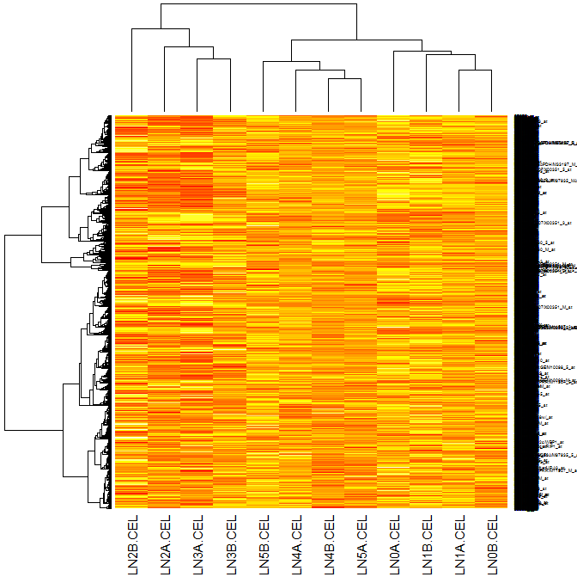

Slide 41
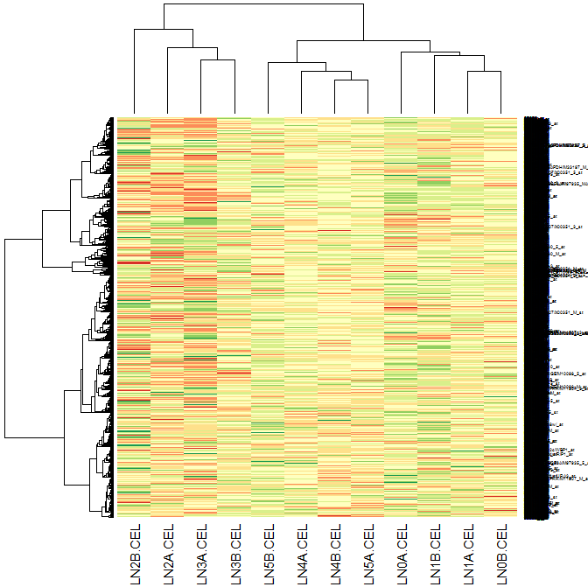

Slide 42
Cautionary Notes
Cluster analysis is by far the most difficult type of analysis one can perform.
Much about how to do cluster analysis is still unknown.
There are many choices that need to be made about distance functions and clustering methods and no clear rule for making the choices

Slide 43
Hierarchical clustering is really most appropriate when there is a true hierarchy thought to exist in the data; an example would be phylogenetic studies.
The ordering of observations in a hierarchical clustering is often interpreted. However, for a given hierarchical clustering of, say, 60 cases, there are 5×10¹⁷ possible orderings, all of which are equally valid. With 9,000 genes, the number of orderings in unimaginably huge, approximate 10²⁷⁰⁰

Slide 44
Exercises
In the ISwR data set alkfos, cluster the data based on the 7 measurements using hclust(), kmeans(), and Mclust().
Compare the 2-group clustering with the placebo/Tamoxifen classification.

