Slide 1
Multivariate Analysis and Discrimination
SPH 247
Statistical Analysis of
Laboratory Data

Slide 2
Cystic Fibrosis Data Set
The 'cystfibr' data frame has 25 rows and 10 columns. It contains lung function data for cystic fibrosis patients (7-23 years old)
We will examine the relationships among the various measures of lung function

Slide 3
age: a numeric vector. Age in years.
sex: a numeric vector code. 0: male, 1:female.
height: a numeric vector. Height (cm).
weight: a numeric vector. Weight (kg).
bmp: a numeric vector. Body mass (% of normal).
fev1: a numeric vector. Forced expiratory volume.
rv: a numeric vector. Residual volume.
frc: a numeric vector. Functional residual capacity.
tlc: a numeric vector. Total lung capacity.
pemax: a numeric vector. Maximum expiratory pressure.

Slide 4
Scatterplot matrices
We have five variables and may wish to study the relationships among them
We could separately plot the (5)(4)/2 = 10 pairwise scatterplots
In R we can use the pairs() function, or the splom() function in the lattice package.
> pairs(lungcap)
> library(lattice)
> splom(lungcap

Slide 6
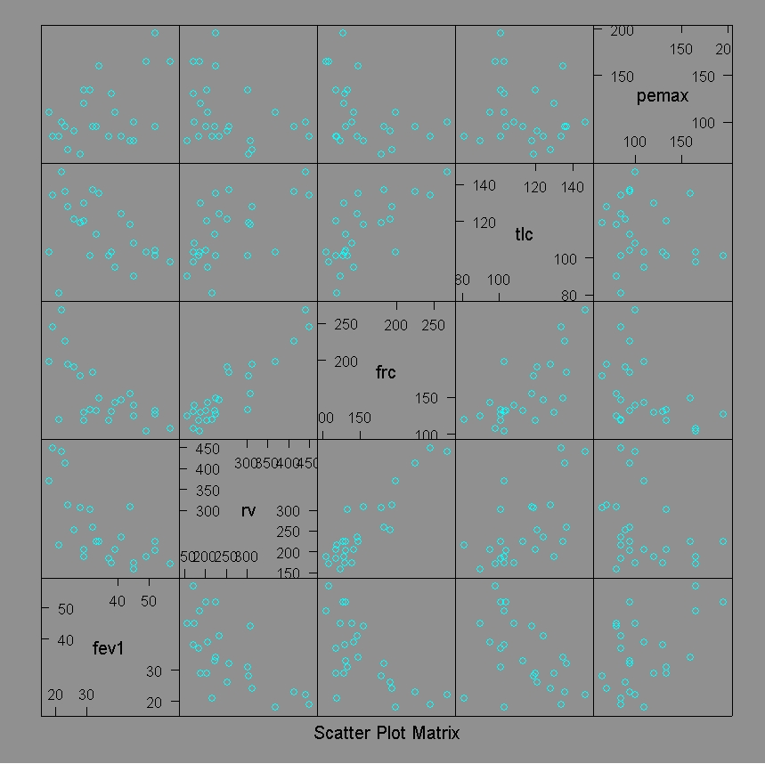

Slide 7
Principal Components Analysis
The idea of PCA is to create new variables that are combinations of the original ones.
If x₁, x₂, …, x_{p} are the original variables, then a component is a₁x₁ + a₂x₂ +…+ a_{p}x_{p}
We pick the first PC as the linear combination that has the largest variance
The second PC is that linear combination orthogonal to the first one that has the largest variance, and so on

Slide 8
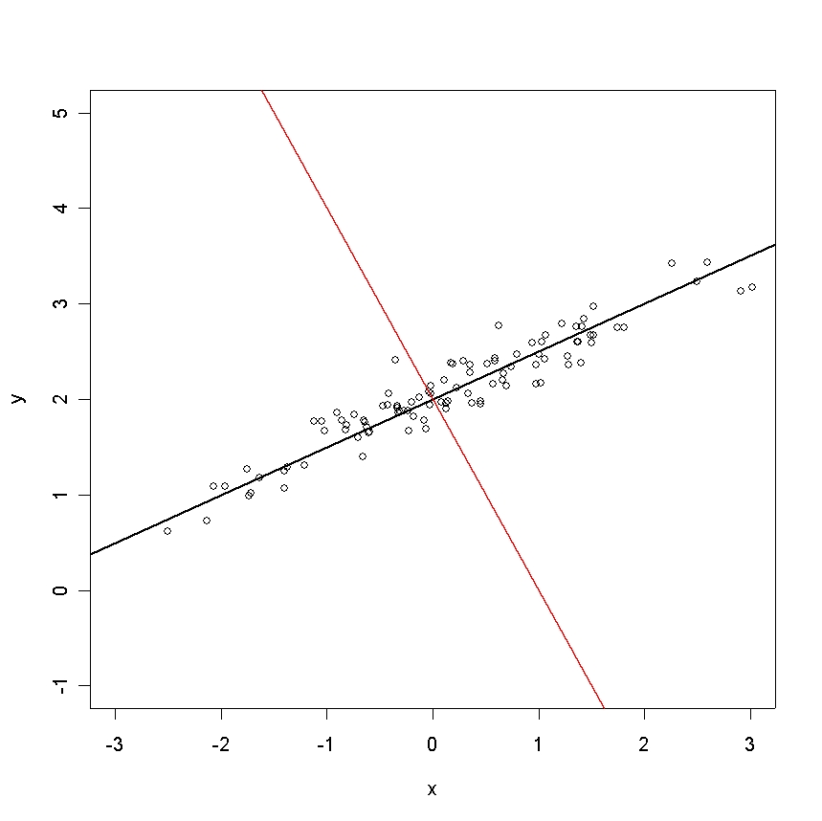

Slide 9
> lungcap.pca <- prcomp(lungcap,scale=T)
> plot(lungcap.pca)
> names(lungcap.pca)
[1] "sdev" "rotation" "center" "scale" "x"
> lungcap.pca$sdev
[1] 1.7955824 0.9414877 0.6919822 0.5873377 0.2562806
> lungcap.pca$center
fev1 rv frc tlc pemax
34.72 255.20 155.40 114.00 109.12
> lungcap.pca$scale
fev1 rv frc tlc pemax
11.19717 86.01696 43.71880 16.96811 33.43691
> plot(lungcap.pca$x[,1:2])
Always use scaling before PCA unless all variables are on the
Same scale. This is equivalent to PCA on the correlation
matrix instead of the covariance matrix

Slide 10
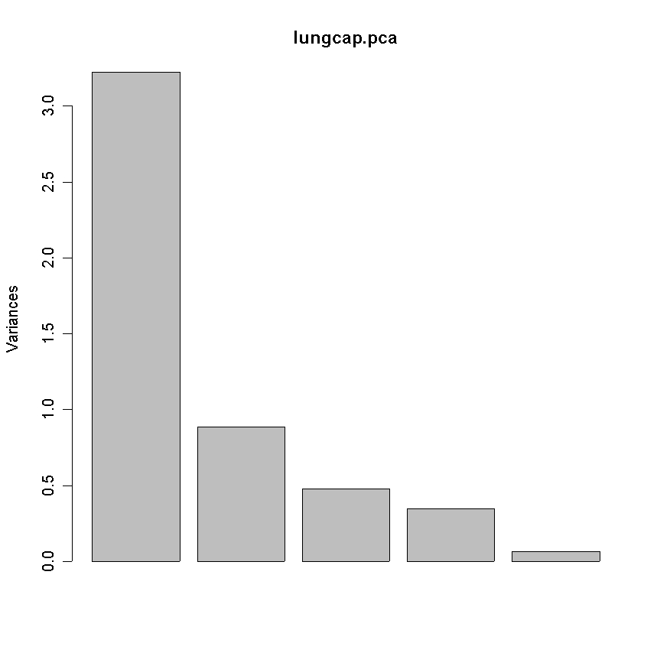
Scree Plot

Slide 11
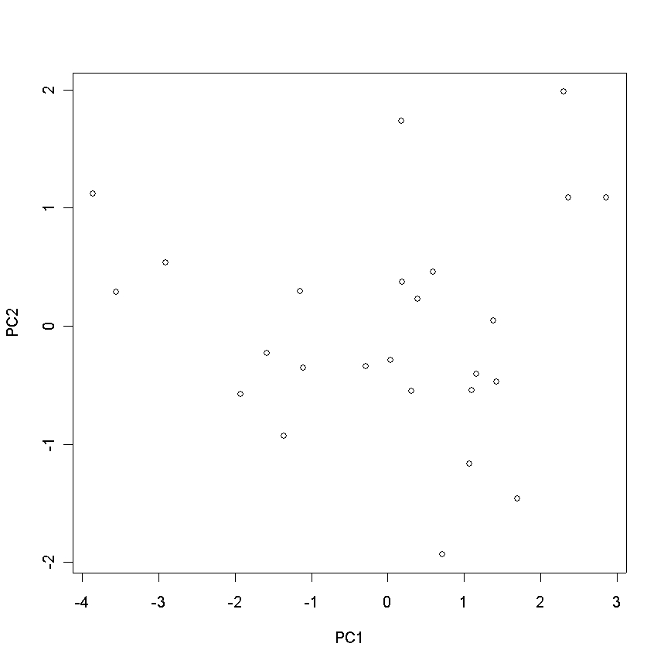

Slide 12
Fisher’s Iris Data
This famous (Fisher's or Anderson's) iris data set gives the measurements in centimeters of the variables sepal length and width and petal length and width, respectively, for 50 flowers from each of 3 species of iris. The species are _Iris setosa_, _versicolor_, and _virginica_.

Slide 13
> data(iris)
> help(iris)
> names(iris)
[1] "Sepal.Length" "Sepal.Width" "Petal.Length" "Petal.Width" "Species"
> attach(iris)
> iris.dat <- iris[,1:4]
> splom(iris.dat)
> splom(iris.dat,groups=Species)
> splom(~ iris.dat | Species)
> summary(iris)
Sepal.Length Sepal.Width Petal.Length Petal.Width Species
Min. :4.300 Min. :2.000 Min. :1.000 Min. :0.100 setosa :50
1st Qu.:5.100 1st Qu.:2.800 1st Qu.:1.600 1st Qu.:0.300 versicolor:50
Median :5.800 Median :3.000 Median :4.350 Median :1.300 virginica :50
Mean :5.843 Mean :3.057 Mean :3.758 Mean :1.199
3rd Qu.:6.400 3rd Qu.:3.300 3rd Qu.:5.100 3rd Qu.:1.800
Max. :7.900 Max. :4.400 Max. :6.900 Max. :2.500

Slide 14
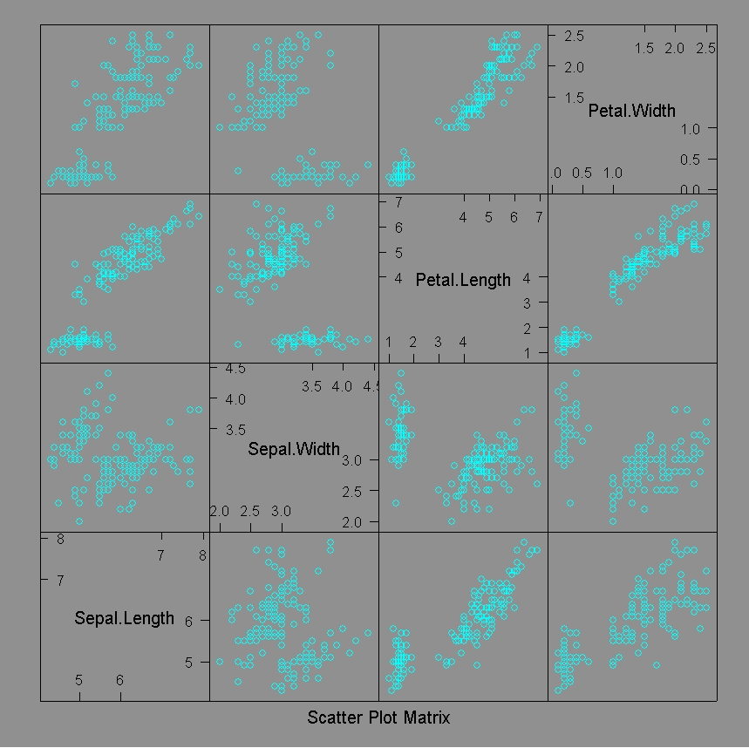

Slide 15
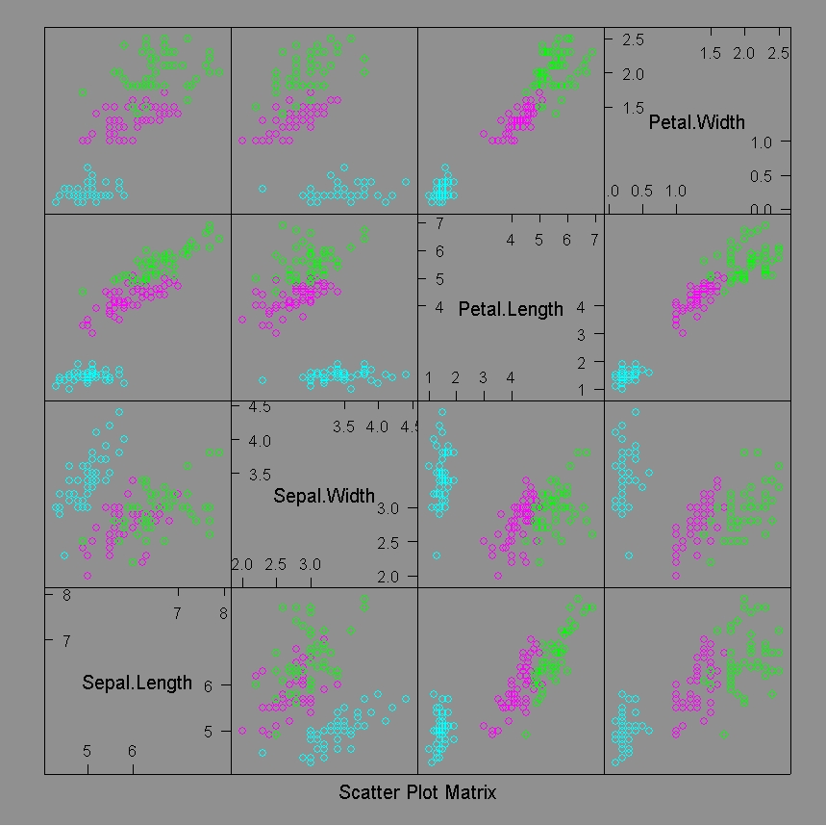

Slide 16
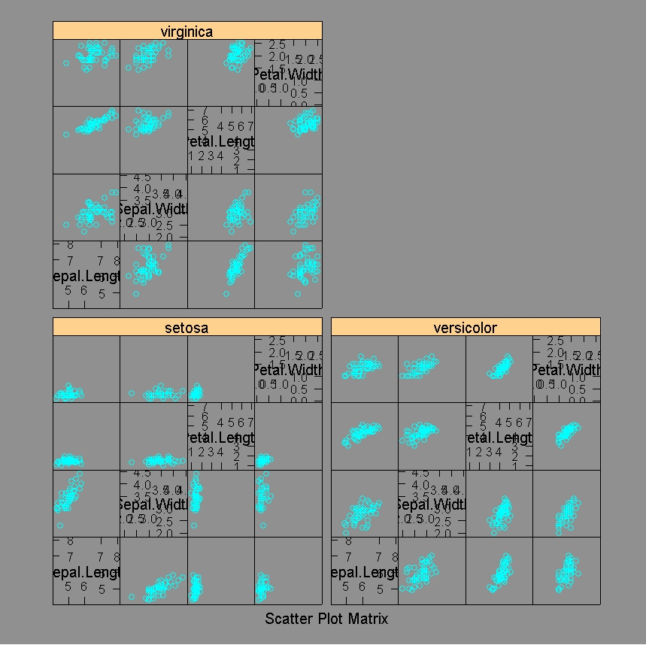

Slide 17
> data(iris)
> iris.pc <- prcomp(iris[,1:4],scale=T)
> plot(iris.pc$x[,1:2],col=rep(1:3,each=50))
> names(iris.pc)
[1] "sdev" "rotation" "center" "scale" "x"
> plot(iris.pc)
> iris.pc$sdev
[1] 1.7083611 0.9560494 0.3830886 0.1439265
> iris.pc$rotation
PC1 PC2 PC3 PC4
Sepal.Length 0.5210659 -0.37741762 0.7195664 0.2612863
Sepal.Width -0.2693474 -0.92329566 -0.2443818 -0.1235096
Petal.Length 0.5804131 -0.02449161 -0.1421264 -0.8014492
Petal.Width 0.5648565 -0.06694199 -0.6342727 0.5235971

Slide 18
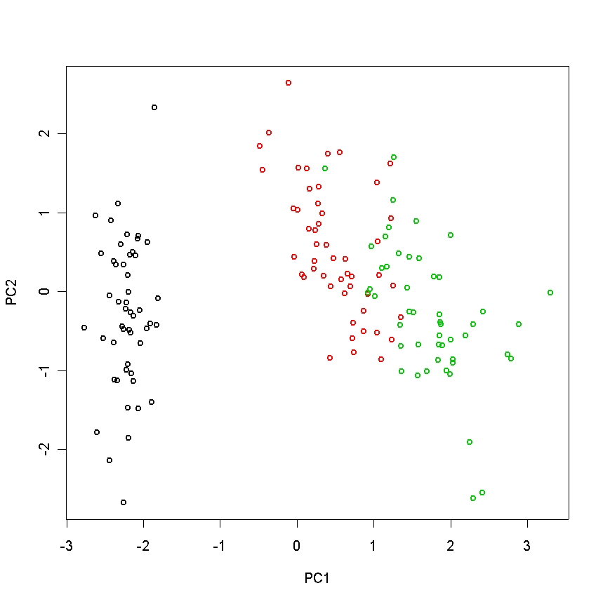

Slide 19
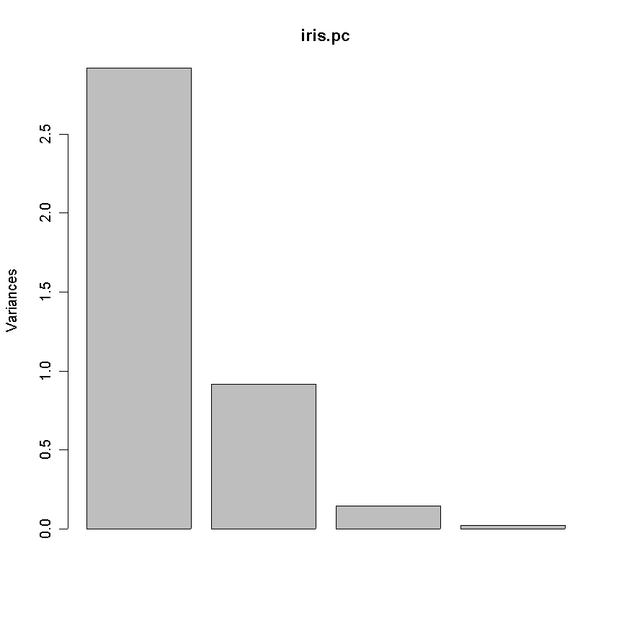

Slide 20
Discriminant Analysis
An alternative to logistic regression for classification is discrimininant analysis
This comes in two flavors, (Fisher’s) Linear Discriminant Analysis or LDA and (Fisher’s) Quadratic Discriminant Analysis or QDA
In each case we model the shape of the groups and provide a dividing line/curve

Slide 21
One way to describe the way LDA and QDA work is to think of the data as having for each group an elliptical distribution
We allocate new cases to the group for which they have the highest likelihoods
This provides a linear cut-point if the ellipses are assumed to have the same shape and a quadratic one if they may be different

Slide 22
> library(MASS)
> iris.lda <- lda(iris[,1:4],iris[,5])
> iris.lda
Call:
lda(iris[, 1:4], iris[, 5])
Prior probabilities of groups:
setosa versicolor virginica
0.3333333 0.3333333 0.3333333
Group means:
Sepal.Length Sepal.Width Petal.Length Petal.Width
setosa 5.006 3.428 1.462 0.246
versicolor 5.936 2.770 4.260 1.326
virginica 6.588 2.974 5.552 2.026
Coefficients of linear discriminants:
LD1 LD2
Sepal.Length 0.8293776 0.02410215
Sepal.Width 1.5344731 2.16452123
Petal.Length -2.2012117 -0.93192121
Petal.Width -2.8104603 2.83918785
Proportion of trace:
LD1 LD2
0.9912 0.0088

Slide 23
> plot(iris.lda,col=rep(1:3,each=50))
> iris.pred <- predict(iris.lda)
> names(iris.pred)
[1] "class" "posterior" "x"
> iris.pred$class[71:80]
[1] virginica versicolor versicolor versicolor versicolor
versicolor versicolor
[8] versicolor versicolor versicolor
Levels: setosa versicolor virginica
> iris.pred$posterior[71:80,]
setosa versicolor virginica
71 7.408118e-28 0.2532282 7.467718e-01
72 9.399292e-17 0.9999907 9.345291e-06
73 7.674672e-29 0.8155328 1.844672e-01
74 2.683018e-22 0.9995723 4.277469e-04
75 7.813875e-18 0.9999758 2.421458e-05
76 2.073207e-18 0.9999171 8.290530e-05
77 6.357538e-23 0.9982541 1.745936e-03
78 5.639473e-27 0.6892131 3.107869e-01
79 3.773528e-23 0.9925169 7.483138e-03
80 9.555338e-12 1.0000000 1.910624e-08
> sum(iris.pred$class != iris$Species)
[1] 3
This is an error rate of 3/150 = 2%

Slide 24
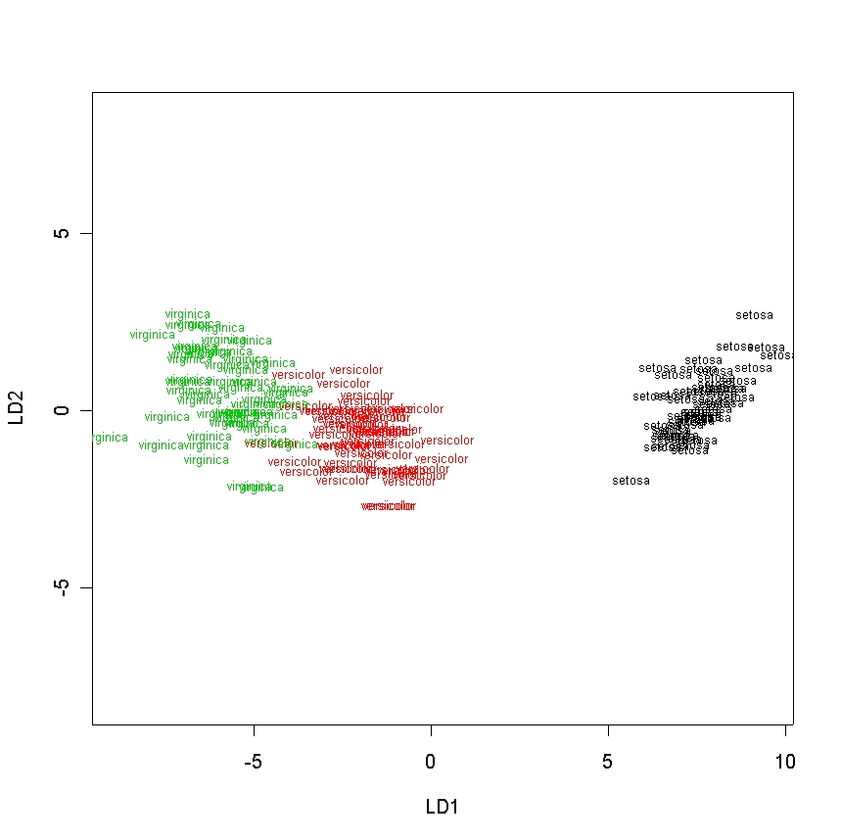

Slide 25
iris.cv <- function(ncv,ntrials)
{
nwrong <- 0
n <- 0
for (i in 1:ntrials)
{
test <- sample(150,ncv)
test.ir <- data.frame(iris[test,1:4])
train.ir <- data.frame(iris[-test,1:4])
lda.ir <- lda(train.ir,iris[-test,5])
lda.pred <- predict(lda.ir,test.ir)
nwrong <- nwrong + sum(lda.pred$class != iris[test,5])
n <- n + ncv
}
print(paste("total number classified = ",n,sep=""))
print(paste("total number wrong = ",nwrong,sep=""))
print(paste("percent wrong = ",100*nwrong/n,"%",sep=""))
}
> iris.cv(10,1000)
[1] "total number classified = 10000"
[1] "total number wrong = 213"
[1] "percent wrong = 2.13%"

Slide 26
Lymphoma Data Set
Alizadeh et al. Nature (2000) “Distinct types of diffuse large B-cell lymphoma identified by gene expression profiling”
We will analyze a subset of the data consisting of 61 arrays on patients with
  45 Diffuse large B-cell lymphoma (DLBCL/DL)
  10 Chronic lymphocytic leukaemia (CLL/CL)
  6 Follicular leukaemia (FL)

Slide 27
Data Available
The original Nature paper
The expression data in the form of unbackground corrected log ratios. A common reference was always on Cy3 with the sample on Cy5 (array.data.txt and array.data.zip). 9216 by 61
A file with array codes and disease status for each of the 61 arrays, ArrayID.txt

Slide 28
Identify Differentially
Expressed Genes
We will assume that the log ratios are on a reasonable enough scale that we can use them as is
For each gene, we can run a one-way ANOVA and find the p-value, obtaining 9,216 of them. We can use apply() or genediff() from LMGene
Adjust p-values with p.adjust or padjust
Identify genes with small adjusted p-values

Slide 29
Develop Classifier
Reduce dimension with ANOVA gene selection or with PCA. (We could also use stepwise logistic regression.)
Use logistic regression or LDA.
Evaluate the four possibilities and their sub-possibilities with cross validation. With 61 arrays one could reasonable omit 10% or 6 at random.

Slide 30
Differential Expression
We can locate genes that are differentially expressed; that is, genes whose expression differs systematically by the type of lymphoma.
To do this, we could use lymphoma type to predict expression, and see when this is statistically significant.
For one gene at a time, this is ANOVA.

Slide 31
It is almost equivalent to locate genes whose expression can be used to predict lymphoma type, this being the reverse process.
If there is significant association in one direction there should logically be significant association in the other
This will not be true exactly, but is true approximately
We can also easily do the latter analysis using the expression of more than one gene using logistic regression, LDA, and QDA

Slide 32
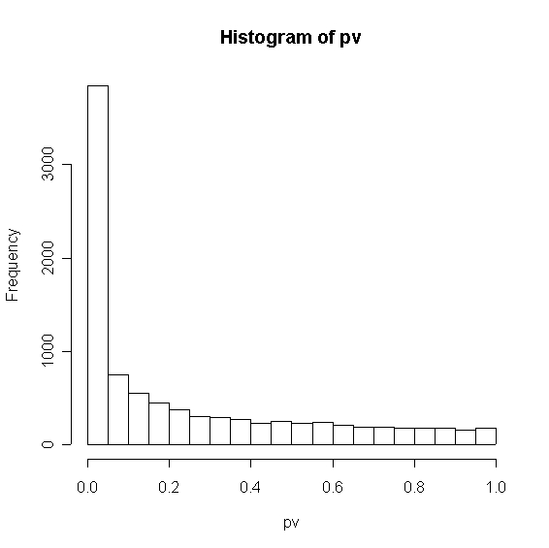

Slide 33
Significant Genes
There are 3845 out of 9261 genes that have significant p-values from the ANOVA of less than 0.05, compared to 463 expected by chance
There are 2733 genes with FDR adjusted p-values less than 0.05
There are only 184 genes with Bonferroni adjusted p-values less than 0.05

Slide 34
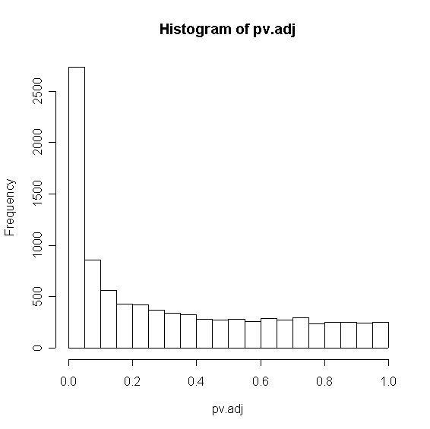

Slide 35
Logistic Regression
We will use logistic regression to distinguish DLBCL from CLL and DLBCL from FL
We will do this first by choosing the variables with the smallest overall p-values in the ANOVA
We will then evaluate the results within sample and by cross validation

Slide 36
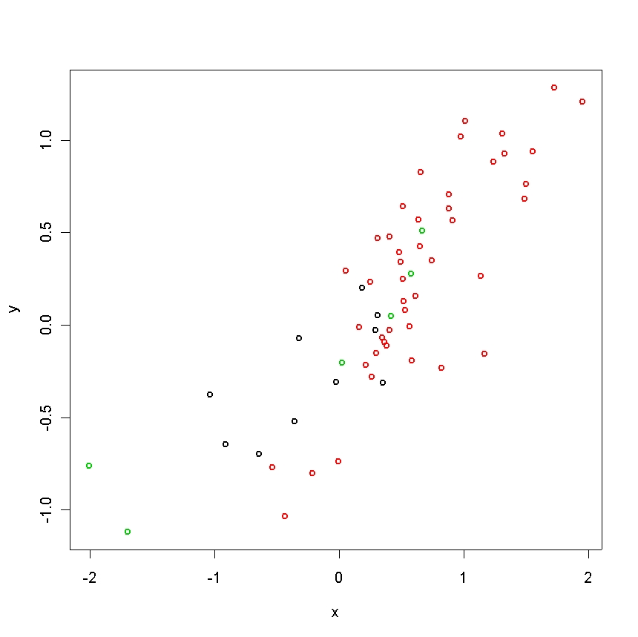

Slide 37
Within Sample Errors
Number of Variables | DL/CL Errors | DL/FL Errors
1 | 7 | 4
2 | 7 | 4
3 | 5 | 5
4 | 0 | 3
5 | 0 | 2
6 | 0 | 0

Slide 38
Evaluation of performance
Within sample evaluation of performance like this is unreliable
This is especially true if we are selecting predictors from a very large set
One useful yardstick is the performance of random classifiers

Slide 39
Number of Variables | Percent Errors
1 | 24.0%
2 | 24.7%
3 | 23.3%
4 | 24.7%
5 | 28.7%
6 | 24.7%
7 | 26.3%
8 | 23.6%
9 | 25.7%
10 | 24.3%
Left is CV
performance of
best k variables
Random =
25.4%

Slide 40
Conclusion
Logistic regression on the variables with the smallest p-values does not work very well
This cannot be identified by looking at the within sample statistics
Cross validation is a requirement to assess performance of classifiers

Slide 41
alkfos {ISwR} R Documentation
Alkaline phosphatase data
Repeated measurements of alkaline phosphatase in a
randomized trial of Tamoxifen treatment of breast cancer
patients.
Format
A data frame with 43 observations on the following 8 variables.
grp a numeric vector, group code (1=placebo, 2=Tamoxifen).
c0 a numeric vector, concentration at baseline.
c3 a numeric vector, concentration after 3 months.
c6 a numeric vector, concentration after 6 months.
c9 a numeric vector, concentration after 9 months.
c12 a numeric vector, concentration after 12 months.
c18 a numeric vector, concentration after 18 months.
c24 a numeric vector, concentration after 24 months.

Slide 42
Exercises
In the ISwR data set alkfos, do a PCA of the placebo and Tamoxifen groups separately, then together. Plot the first two principal components of the whole group with color coding for the treatment and control subjects.
Conduct a linear discriminant analysis of the two groups using the 7 variables. How well can you predict the treatment? Is this the usual kind of analysis you would see?
Use logistic regression to predict the group based on the measurements. Compare the in-sample error rates.
Use cross-validation with repeated training subsamples of 38/43 and test sets of size 5/43. What can you now conclude about the two methods?

